Slide 1
Arduino starter pack ii (a.s.p)
mcbUCHAREST@GMAIL.COM
Random guy who tells you stuff: P.P.F.

Slide 2
Short summary:
What is a button and how it works
Serial communication and Serial.print function
Simple ARDUINO blink-when-pushed code
Building a much more complex code
Building a much more circuit
Simple functions

Slide 3
WHAT IS SERIAL COMMUNICATION:
Serial is used for communication between the Arduino board and a computer or other devices.
All Arduino boards have at least one serial port (also known as a UART or USART): Serial. It communicates on digital pins 0 (RX) and 1 (TX) as well as with the computer via USB.
If you use these functions, you CANNOT also use pins 0 and 1 for digital input or output.

Slide 4
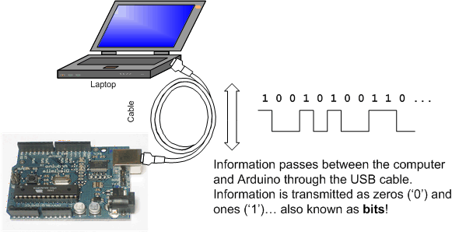
HOW IT WORKS:

Slide 5
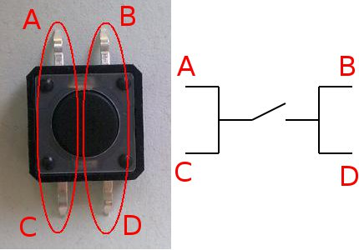
How does a button work:

Slide 6
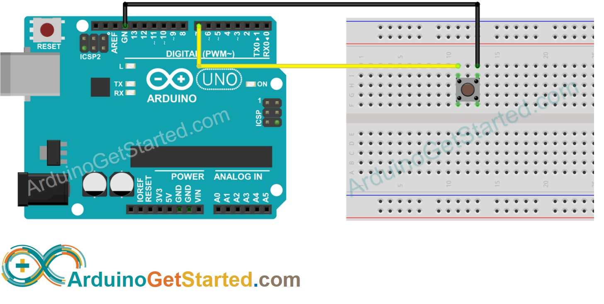
Sample arudino and button circuit:

Slide 7
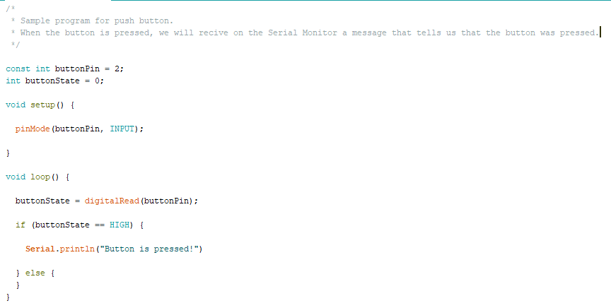
Sample Arduino push button code:

Slide 8
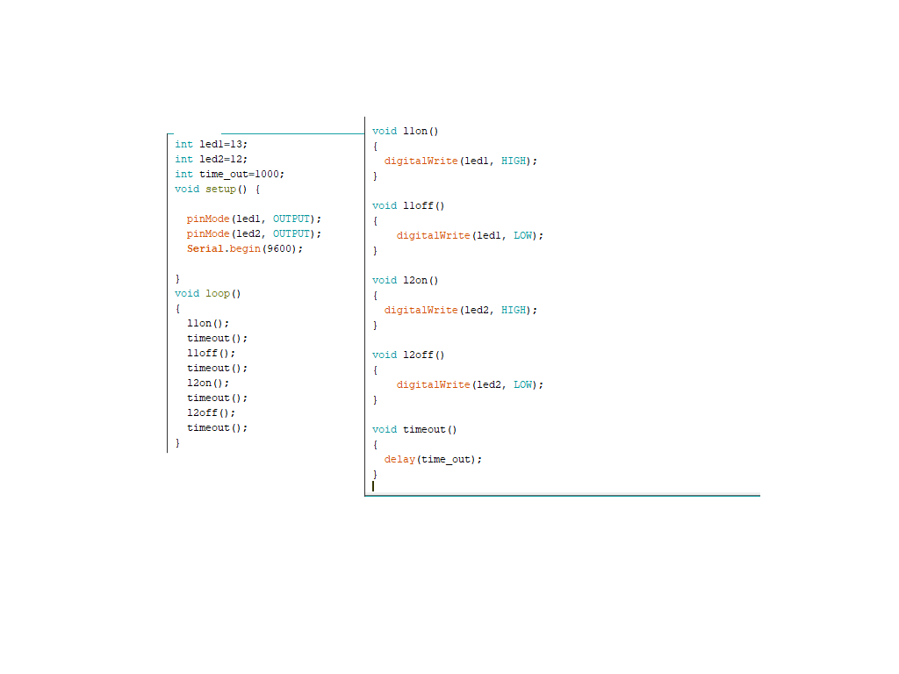
Arduino simple functions:

Slide 9
Arduino functions & push button task:
Now lets try and combine the simple Arduino push button code and the functions, to make an easy modifiable code
We need to make a code that when the button is pressed, the green led is on and the red one off, and when the button is not pressed, the green led is off and the red one is on
We need to see on the Serial Monitor the status of the LEDs as well.

Slide 10
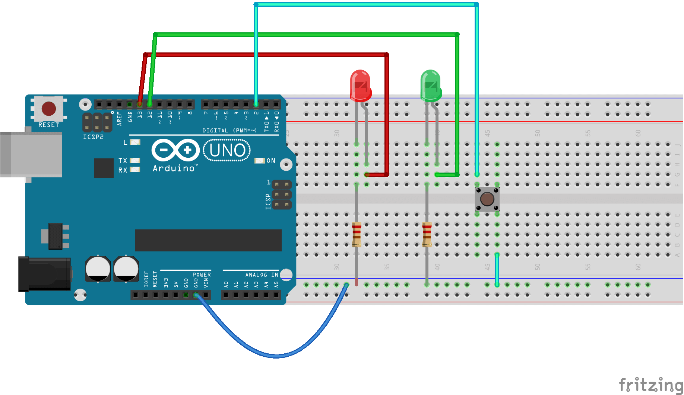
Task one-the hardware:

Slide 11
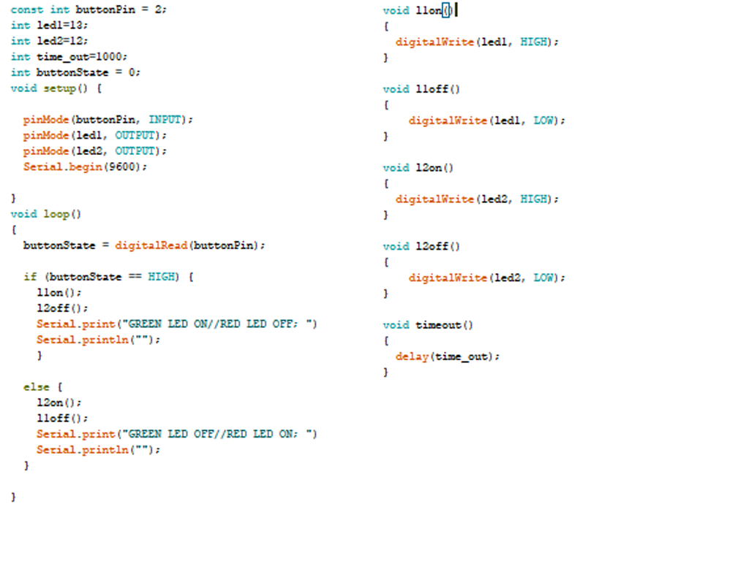
Task two-the software:

Slide 12
Webography:
https://en.wikipedia.org/wiki/Light-emitting_diode
https://www.arduino.cc/en/tutorial/button
https://www.arduino.cc/reference/en/language/functions/communication/serial/
https://www.instructables.com/id/How-to-use-a-Push-Button-Arduino-Tutorial/

